Slide 1
Learning Objective
I will use the area of triangle rule to solve for the area of non-right angled triangle.
Success Criteria
At the end of the lesson, I will be able to:
Determine the area of a non-right angled triangle.
Determine the unknown sides and angles given the area of triangle

Slide 2
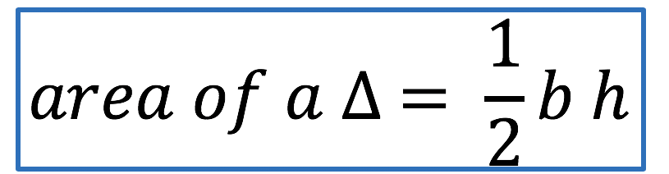
Area of a triangle
Concept Development
h
h
b
b

Slide 3

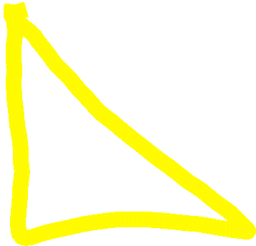

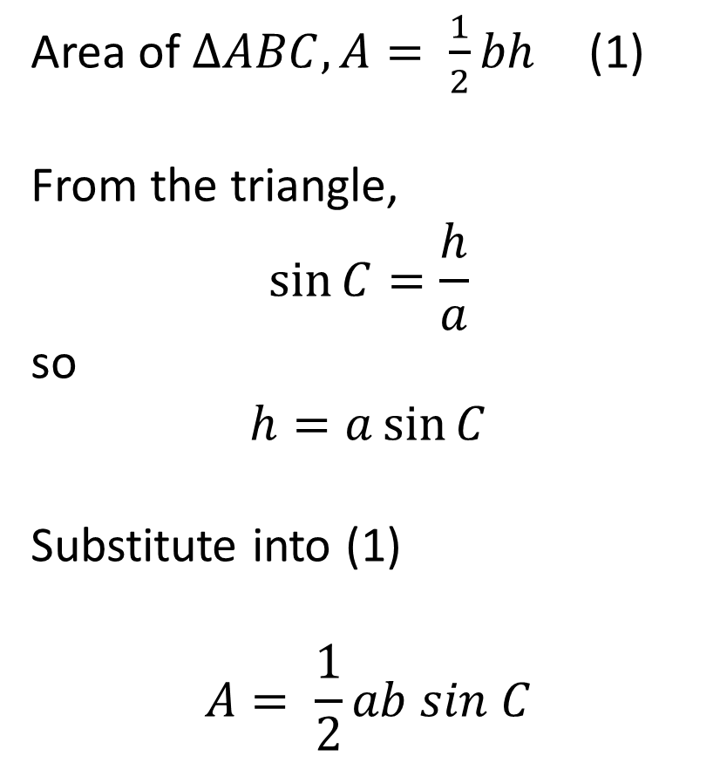

Area of triangle – Non-right angled triangle
B
Area of $ΔABC, A= \frac{1}{2}bh$ (1)
From the triangle,
$$\sin{C=\frac{h}{a}}$$
so
$$h=a\sin{C}$$
Substitute into (1)
$$A= \frac{1}{2}ab sin C$$
$$a$$
$$h$$
A
C
$$b$$

Slide 4
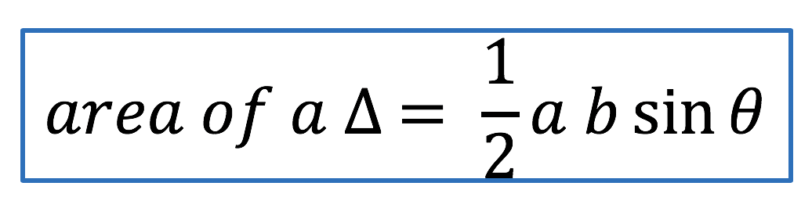
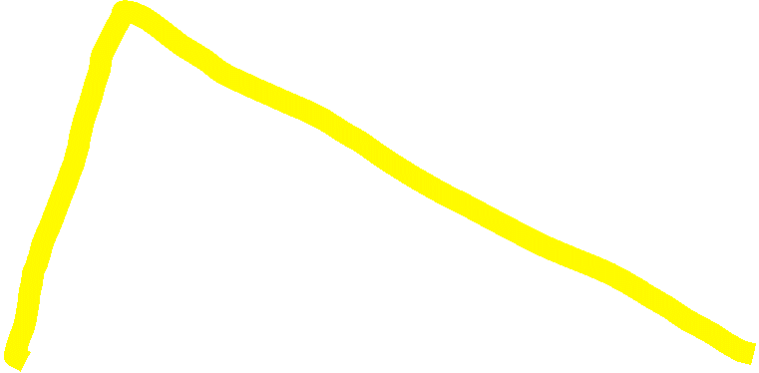



Concept Development
C
$$θ$$
b
a
B
A

Slide 5
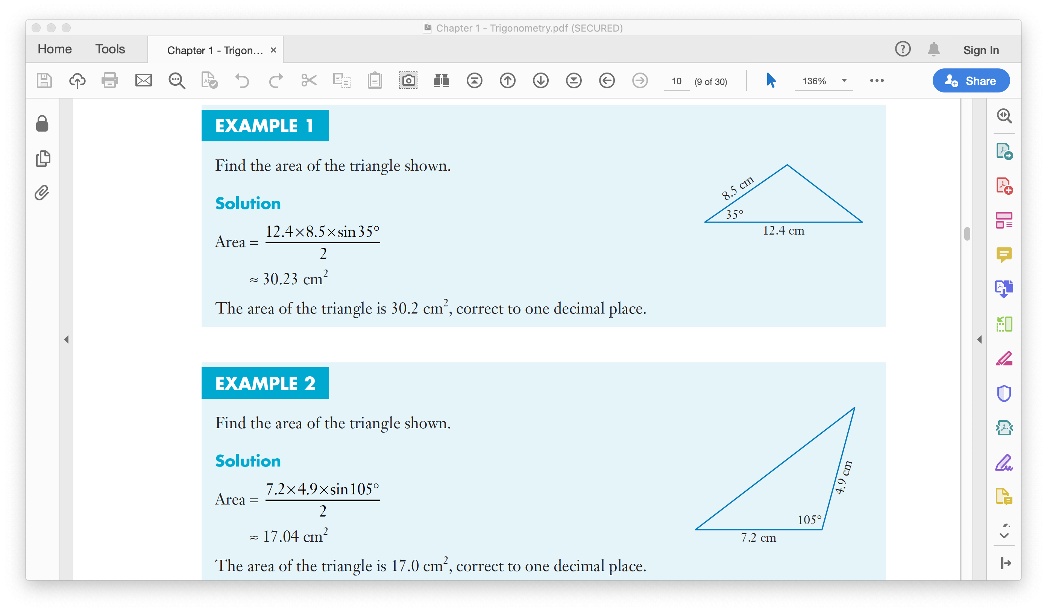
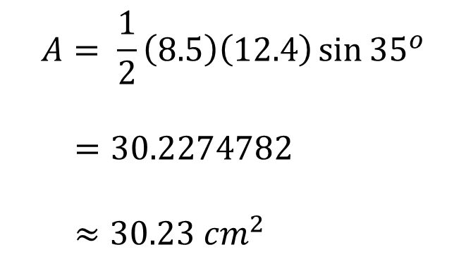
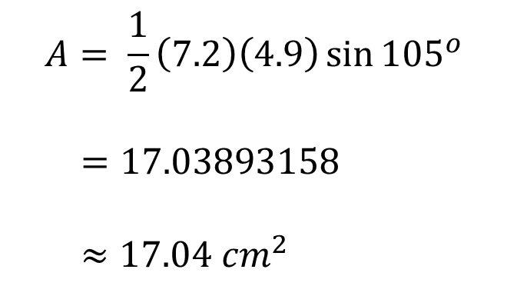
Guided Practice
$$A= \frac{1}{2}\left(8.5\right)\left(12.4\right)\sin{{35}^{o}}$$
$=30.2274782$
$≈30.23 {cm}^{2}$
$$A= \frac{1}{2}\left(7.2\right)\left(4.9\right)\sin{{105}^{o}}$$
$=17.03893158$
$≈17.04 {cm}^{2}$

Slide 6
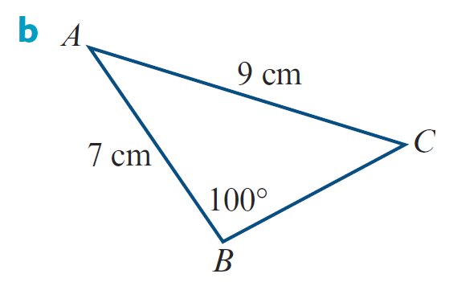
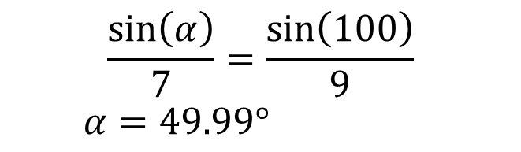
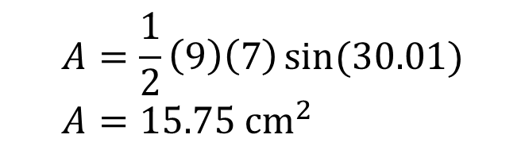
Find the area of the following triangle.
Guided Practice
$$\frac{\sin\left(α\right)}{7}=\frac{\sin\left(100\right)}{9}$$
$α=49.99°$
$θ=180−100−49.99=30.01°$
$$A=\frac{1}{2}\left(9\right)\left(7\right)\sin{(30.01)} \\ A=15.75 {cm}^{2}$$

Slide 7
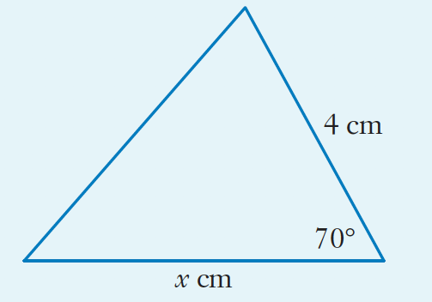
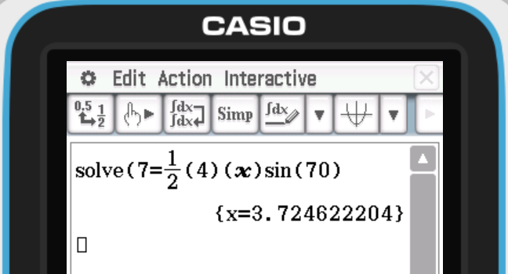

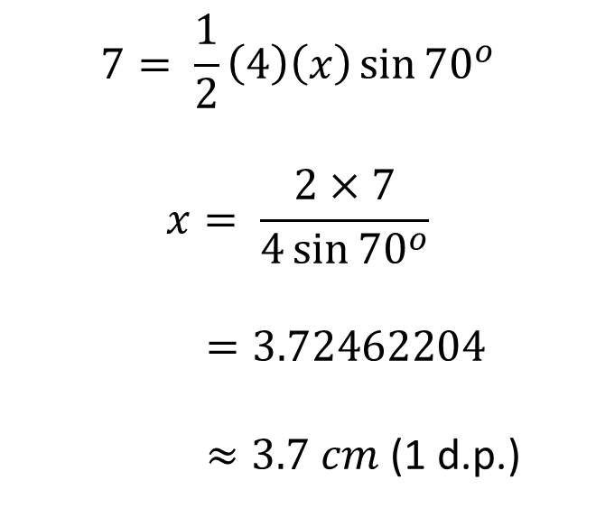
Guided Practice
$$7= \frac{1}{2}\left(4\right)\left(x\right)\sin{{70}^{o}}$$
$$x= \frac{2×7}{4\sin{{70}^{o}}}$$
$=3.72462204$
$≈3.7 cm$ (1 d.p.)
$$A=7 {cm}^{2}$$

Slide 8
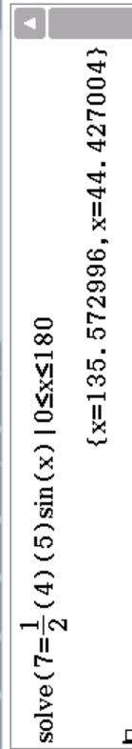
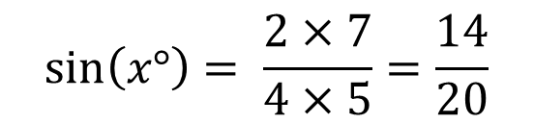
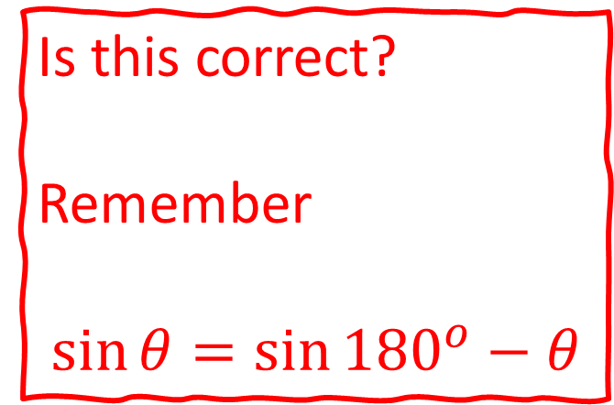

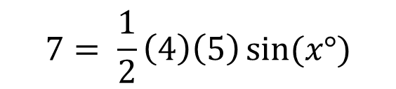
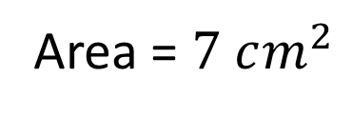




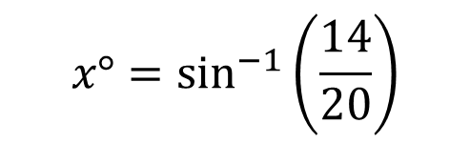
The two sides of a triangle are 4 cm and 5 cm respectively. Given that the area of that triangle is 7 cm², what is the angle between the two sides?
Guided Practice
$$7= \frac{1}{2}\left(4\right)\left(5\right)\sin{(x°)}$$
Is this correct?
Remember
$$\sin{θ}=\sin{{180}^{o}−θ}$$
$$\sin\left(x°\right)= \frac{2×7}{4×5}=\frac{14}{20}$$
$$x$$
$$4$$
$$5$$
$$x°=\sin^{−1}\left(\frac{14}{20}\right)$$
Area = $7 cm^{2}$
$$x°≈44.43°$$
$$x°≈180°−44.43°=135.57°$$

Slide 9
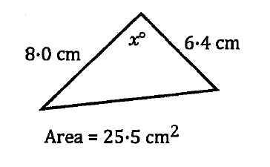
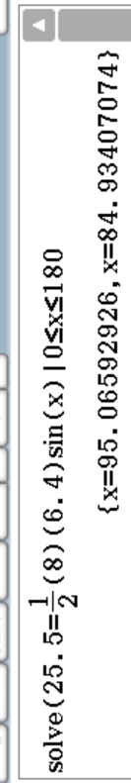

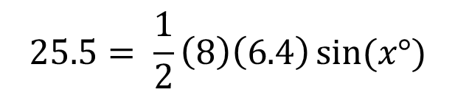
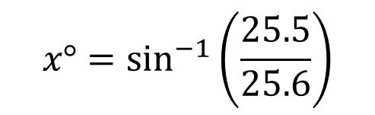

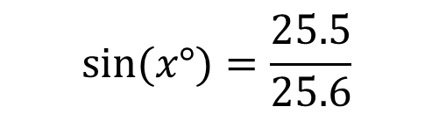
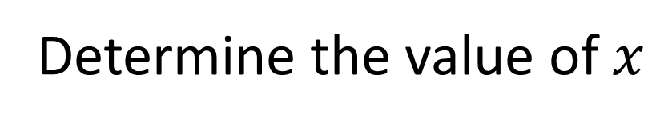
Guided Practice
Determine the value of $x$
$$25.5= \frac{1}{2}\left(8\right)\left(6.4\right)\sin{(x°)}$$
$$25.5=25.6\sin{(x°)}$$
$$\sin{(x°)}=\frac{25.5}{25.6}$$
$$x°=\sin^{−1}\left(\frac{25.5}{25.6}\right)$$
$$x°≈84.93°, 95.07°$$

Slide 10

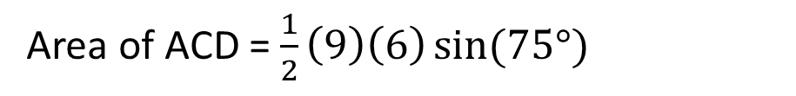
Calculate the area of the quadrilateral
Guided Practice
Area of ABC = $\frac{1}{2}\left(4\right)\left(7\right)\sin{(115°)}$
7
6
Area of ABC = 13.68830902
115º
75º
Area of ACD = $\frac{1}{2}\left(9\right)\left(6\right)\sin{(75°)}$
4
9
Area of ACD = 26.07999731
(measurements in mm)
Area of ABCD = 13.68830902 + 26.07999731 $≈$ 38.77 mm²

Slide 11
Independent Practice
Complete Cambridge Ex 13D

